Slide 1
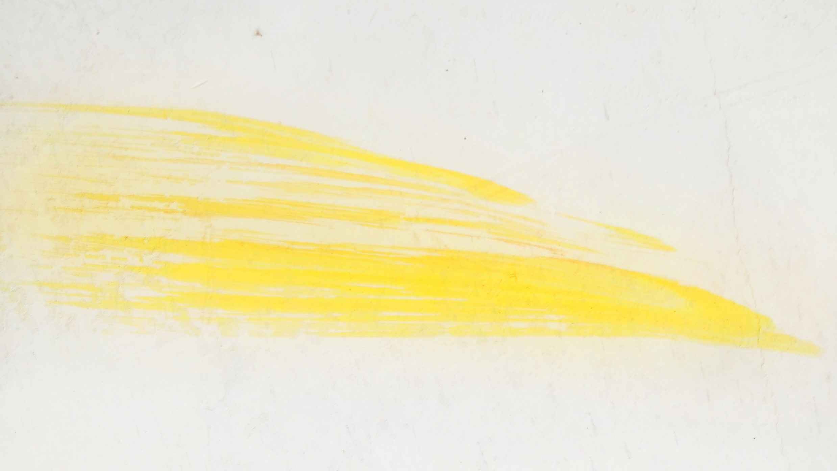

E-LEARNING DESIGN TRENDS
2021

Slide 2
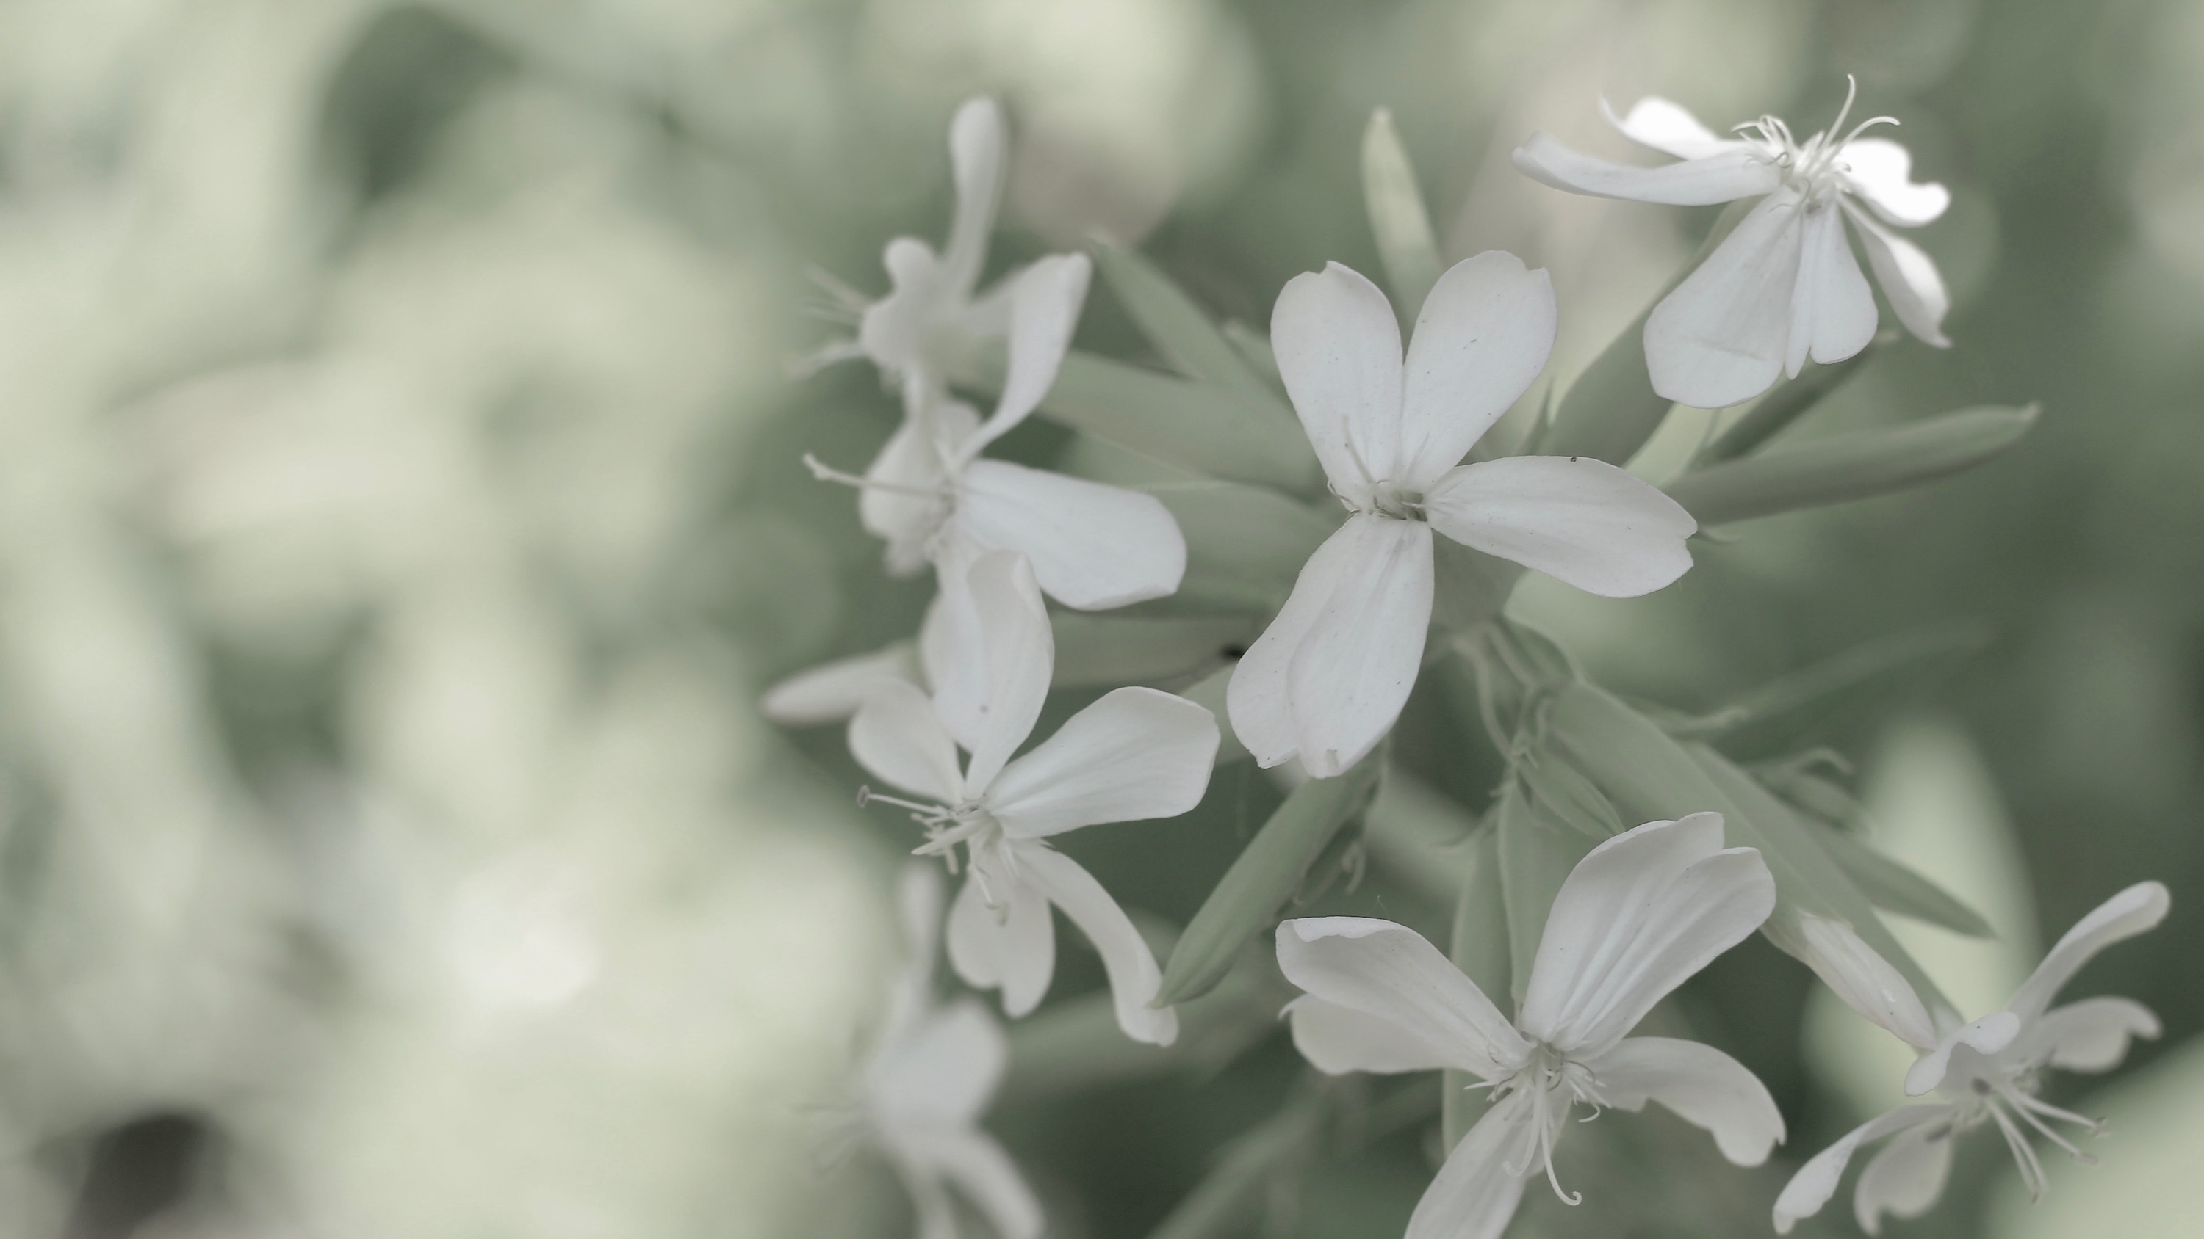
MUTED COLORS
Low saturation colors that appear more natural and organic. Safe and soothing.

Slide 3

GEOMETRIC SHAPES
Easily-recognizable shapes and patterns with more fixed, defined edges. Simple and consistent.

Slide 4


NATURE-INSPIRED DESIGN
The outdoors creep inside with natural textures and realistic imagery. Organic and earthy.

Slide 5
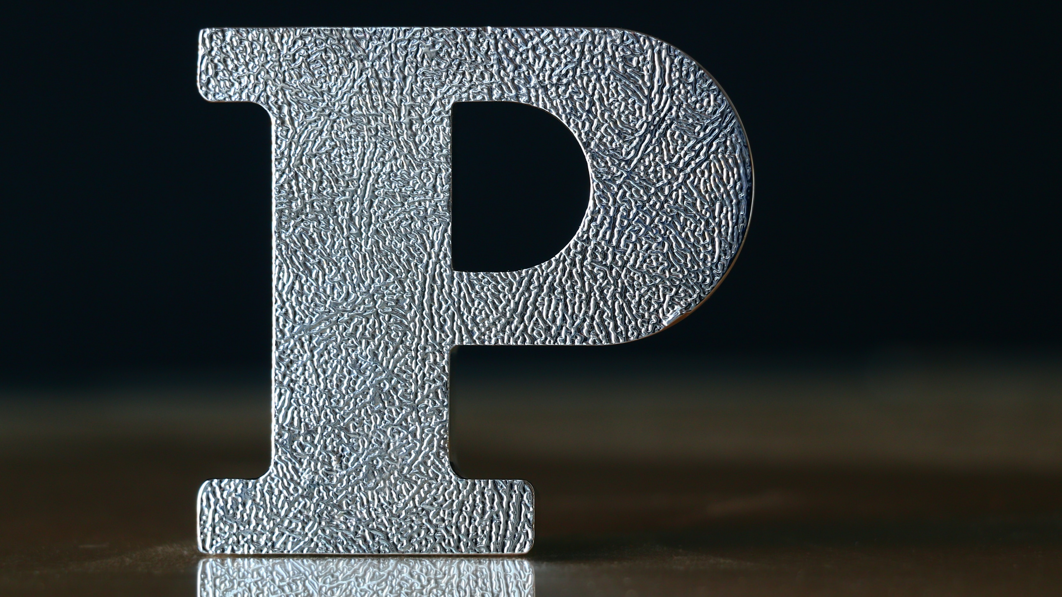
FAMILIAR FONTS
Resurgence of classic typestyles and iconic fonts. Retro and nostalgic.

Slide 6

DATA SIMPLIFIED
Data visualizations that draw people in and communicate effectively. Clear and uncomplicated.

Slide 7

INCLUSIVE DESIGN
Imagery, language, and design that accommodates learners from all backgrounds and abilities. Accessible and diverse.

Slide 8
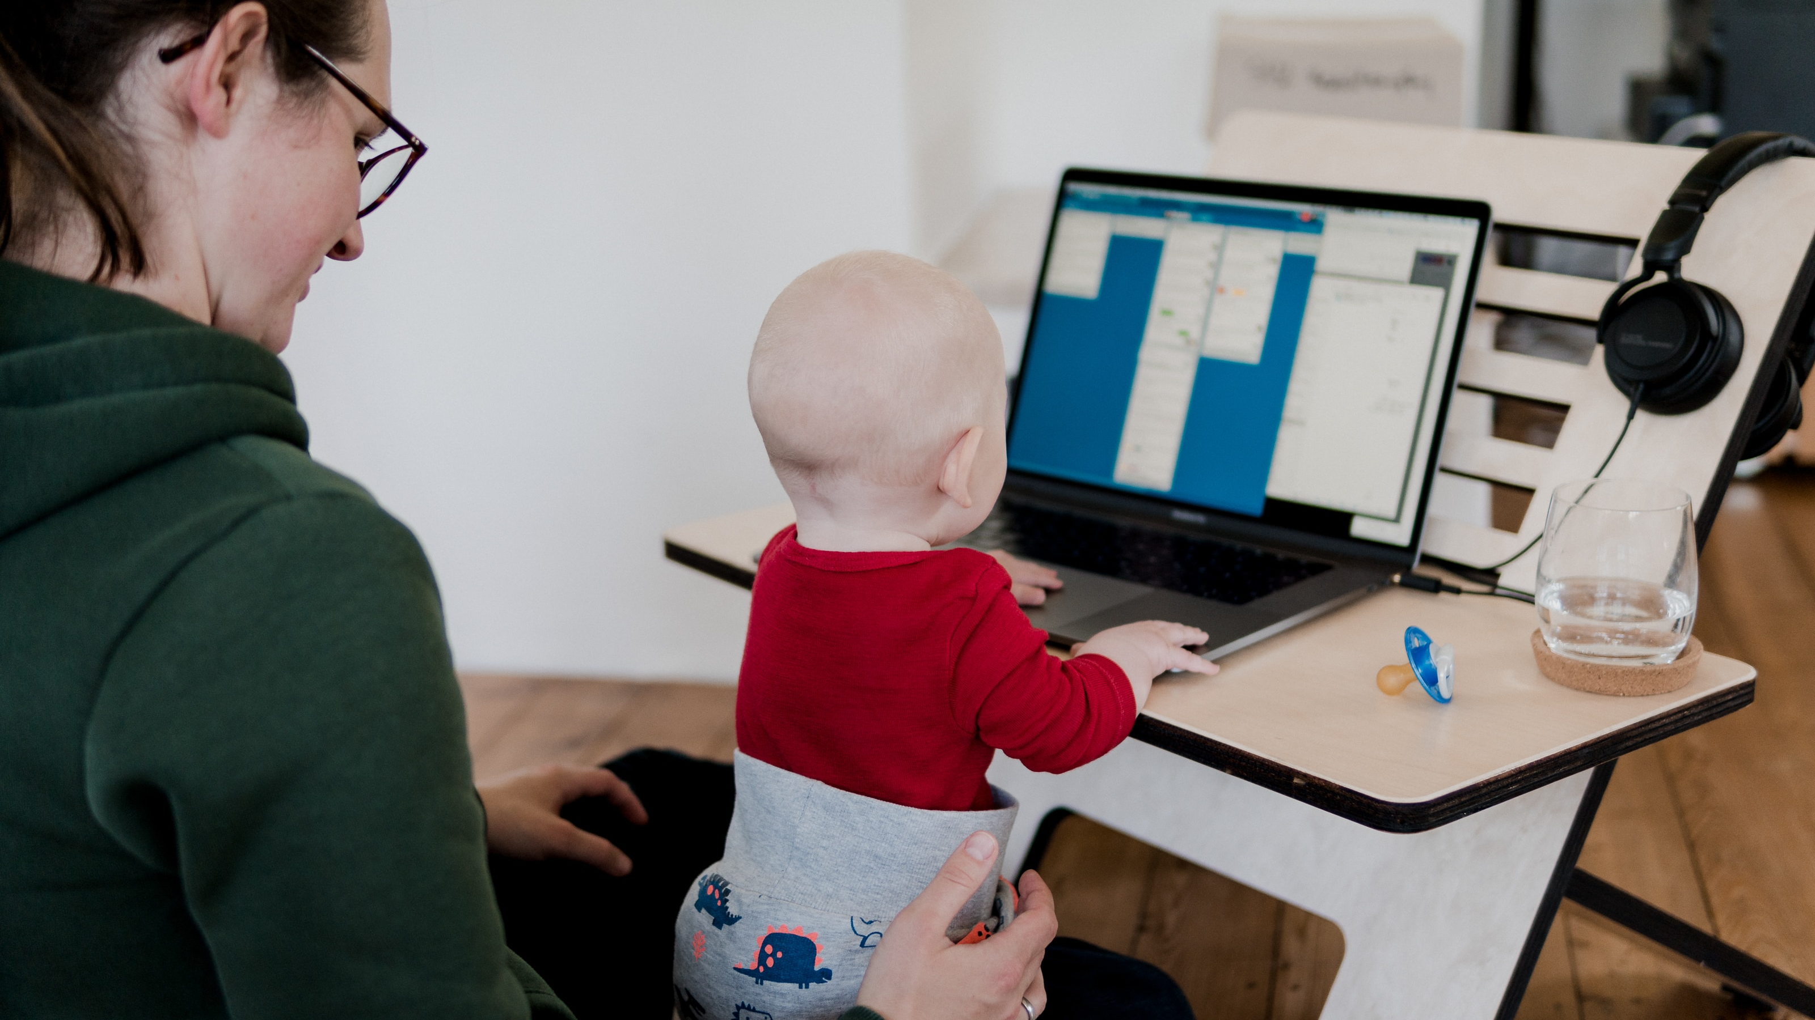

DEMOCRATIZED E-LEARNING
Distributed workforces with a need for highly collaborative content development and distribution capabilities. Nimble and scalable.

